Slide 1

WAIDI Medical Advisors Team
WHAT
* For privacy reasons, we have anonymized names with respective affiliation
Reliable Data
Sources
Patient Profiling
Individualized Therapeutic Target
Pharmacologic Therapeutics
Non-pharmacologic Therapeutics
User friendliness
(USF Sto. A. Cavaleiros)
(USF Fenix, Vila Real)
Biguanidas e Outros (2)
(CS S. Vicente, Madeira)
(USF Alfena, Paredes)
(USF Antonina,V.N.Famalicão)
(USF T.Almeida, V. Castelo)
iDPP4 (2)
(USF Renascer, Gondomar)
(USF V. Saude, Aveiro)
(USF Vila Franca Xira)
iSGLT2 (2)
(USF Nova Saude, Sto Tirso)
aGLP1 (2)
COORDINATORS
Insulinas (2)
(USF Colares, Sintra)
(USF Marco Canaveses)
(USF Caldas da Rainha)
(USF Marmelais, Tomar)
(USF Luisa Todi, Setubal)
(HDES, Ponta Delgada)
(HFAR, Lisboa)
(USF Carnaxide, Oeiras)
(USF Cidade Jardim, Viseu)
(USF Descobrimentos Lagos)
13
INTRODUCING WAIDI
MUNDIPHARMA & IBM CONFIDENCIAL

Slide 2

DATA SOURCES
WHAT
Guidelines,
ADA, SIGN, AACE,DGS, NICE,SPD
Patient profile
variables, risk factors, diagnosis
…..
Individualized therapeutic target variables, weighting, equations target definition
Other sources,
Scientific papers, publications, KPIs
Pharmacologic therapeutics
Therapeutic classification, RCM.
Non pharmacologic therapeutics
Physical activity, nutrition
11
INTRODUCING WAIDI
MUNDIPHARMA & IBM CONFIDENCIAL

Slide 3
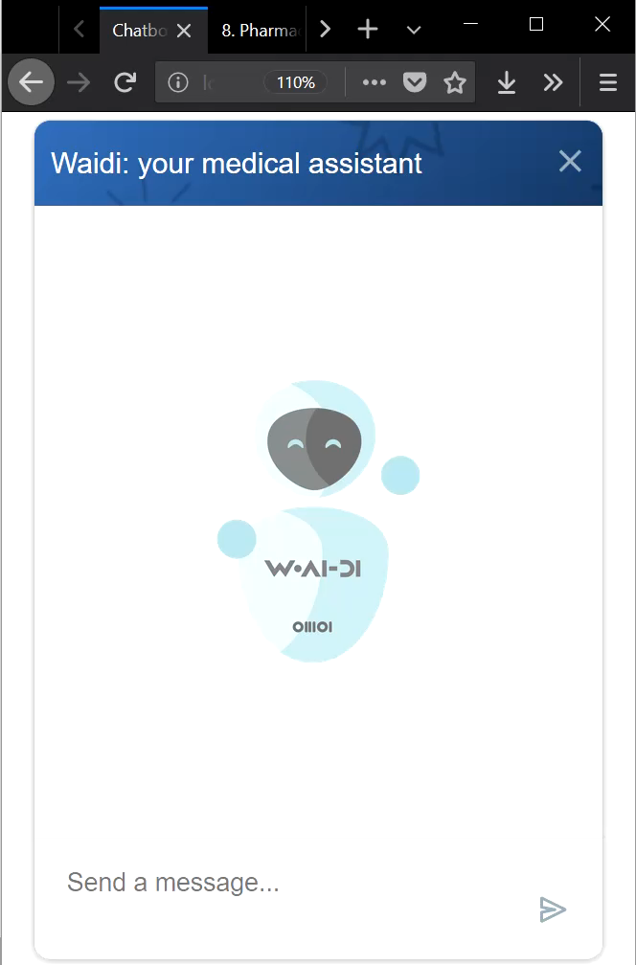
DEMO
VÍDEO
14
INTRODUCING WAIDI
MUNDIPHARMA & IBM CONFIDENCIAL

